Slide 1
Chapter 1
Modern Project Management

Slide 2
What is a Project?
Project Defined
  A complex, nonroutine, one-time effort limited by time, budget, resources, and performance specifications designed to meet customer needs.
Major Characteristics of a Project
  Has an established objective.
  Has a defined life span with a beginning and an end.
  Requires across-the-organizational participation.
  Involves doing something never been done before.
  Has specific time, cost, and performance requirements.

Slide 3
Programs versus Projects
Program Defined
  A series of coordinated, related, multiple projects that continue over an extended time and are intended to achieve a goal.
  A higher level group of projects targeted at a common goal.
  Example:
    Project: completion of a required course in project management.
    Program: completion of all courses required for a business major.

Slide 4
Comparison of Routine Work with Projects
Routine, Repetitive Work
Taking class notes
Daily entering sales receipts into the accounting ledger
Responding to a supply-chain request
Practicing scales on the piano
Routine manufacture of an Apple iPod
Attaching tags on a manufactured product
Projects
Writing a term paper
Setting up a sales kiosk for a professional accounting meeting
Developing a supply-chain information system
Writing a new piano piece
Designing an iPod that is approximately 2 X 4 inches, interfaces with PC, and stores 10,000 songs
Wire-tag projects for GE and
Wal-Mart
TABLE 1.1

Slide 5
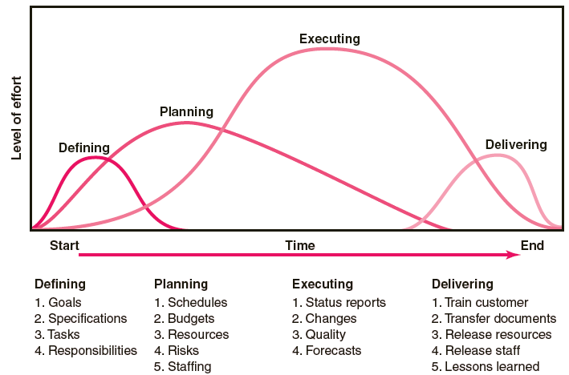
Project Life Cycle
FIGURE 1.1

Slide 6
The Challenge of Project Management
The Project Manager
  Manages temporary, non-repetitive activities and frequently acts independently of the formal organization.
    Marshals resources for the project.
    Is linked directly to the customer interface.
    Provides direction, coordination, and integration to the project team.
    Is responsible for performance and success of the project.
  Must induce the right people at the right time to address the right issues and make the right decisions.

Slide 7

The Importance of Project Management
Factors leading to the increased use of project management:
  Compression of the product life cycle
  Global competition
  Knowledge explosion
  Corporate downsizing
  Increased customer focus
  Rapid development of Third World and closed economies
  Small projects that represent big problems

Slide 8
Integrated Project Management Systems
Problems resulting from the use of piecemeal project management systems:
  Do not tie together the overall strategies of the firm.
  Fail to prioritize selection of projects by their importance of their contribution to the firm.
  Are not integrated throughout the project life cycle.
  Do not match project planning and controls with organizational culture to make appropriate adjustments in support of project endeavors.

Slide 9
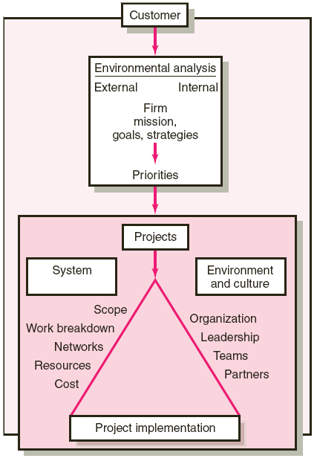
Integrated Management of Projects
FIGURE 1.2

Slide 10
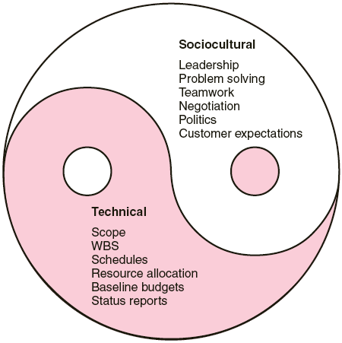
The Technical and Sociocultural Dimensions
of the Project Management Process
FIGURE 1.3

Slide 11
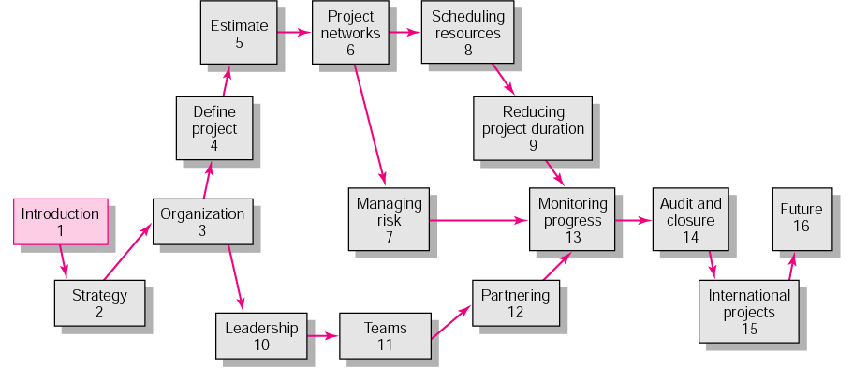
An Overview of Project Management 3e.

Slide 12
Key Terms
Program
ISO 9000
Project
Project life cycle
Sociotechnical perspective

